Slide 1

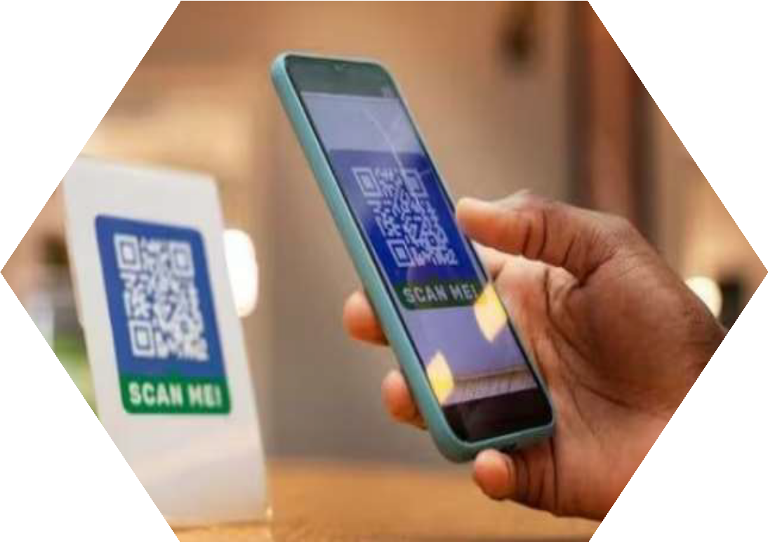
Department of Data Science SY B.Sc. (Data Science)
Smt. CHM Collage, Ulhasnagar, University of Mumbai
Field Project Report
On
Adoption of UPI and Cashless Economy
-A Field Investigation
Submitted by:
Rehan, Soham, Grishma, Khushi, and Pradnya
Under the Guidance of:
DR. Shiji Johnson
Empowering India’s Digital Future through Data Science…
Date:10 Nov 2025

Slide 2

CERTIFICATE OF COMPLETION
Smt. C.H.M. College (Autonomous)
Department of Data Science
Mumbai University
This certificate is proudly awarded to:
Rehan Khan 11, Soham Morye 19, Grishma Patil 24, Pradnya Ughade 33, and Khushi Mishra 17
for successfully completing the Field Project Report.
Title: “Adoption of UPI & Cashless Economy - A field investigation”
during the academic year 2025-2026, in partial fulfillment of the requirements for the
Bachelor of Science (Data Science) degree under Mumbai University.
The project reflects exceptional teamwork, analytical thinking, and professional understanding of digital payment systems and their adoption among youth.
Guided by:
DR. Shiji Johnson
Head of Department, Data Science
Smt. C.H.M. College (Autonomous), Mumbai University
Signature of HOD
Signature of Principal
Date:10 November 2025
Place: Smt. C.H.M. College, Ulhasnagar

Slide 3
Acknowledgment
We would like to express our heartfelt gratitude to Dr. Shiji Johnson, Head of the Department, Data Science, Smt. C.H.M. College, for her invaluable guidance, continuous encouragement, and unwavering support throughout the completion of this field project.
We are sincerely thankful to the Department of Data Science for providing us with the academic foundation, tools, and learning environment that empowered us to apply analytical concepts to real-world data.
Our appreciation also extends to all the survey participants who shared their valuable responses, enabling us to conduct a meaningful and data-driven analysis of UPI adoption.
Lastly, we would like to acknowledge the consistent teamwork and dedication of our group members :- Soham Morye, Rehan Khan, Grishma Patil, Khushi Mishra, and Pradnya Ughade - whose collaboration and individual contributions made this project a success.
This report represents the collective effort, analytical mindset, and shared vision
of our team to explore India’s digital transformation through data science.

Slide 4
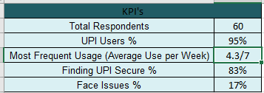
Executive Summary
This project delivers a comprehensive, data-driven study on the adoption of UPI and the growth of India’s cashless economy, highlighting how youth are shaping the future of digital transactions.
Primary data were collected through a nationwide Google Form survey, capturing 60 valid responses from students and young adults across different regions of India. The responses were refined using Power Query to remove inconsistencies, standardize entries, and ensure data accuracy.
The cleaned dataset was analyzed through Microsoft Excel using PivotTables, charts, and KPI dashboards to identify key behavioral patterns. Results revealed that 93% of respondents actively use UPI, with Google Pay (46%) and PhonePe (32%) leading as preferred applications. The analysis also found that 18–25-year-olds perform the highest number of digital transactions, reflecting a generational shift toward fintech-driven convenience.
Insights from this project demonstrate that while UPI adoption is nearly universal among students, challenges such as transaction delays, network issues, and security concerns persist. These findings emphasize the importance of continuous innovation and user trust in sustaining the digital finance ecosystem.
By combining data collection, Power Query–based cleaning, and Excel dashboard visualization, this study bridges academic learning with real-world financial analytics - aligning with India’s vision of becoming a cashless, data-driven economy

Slide 5
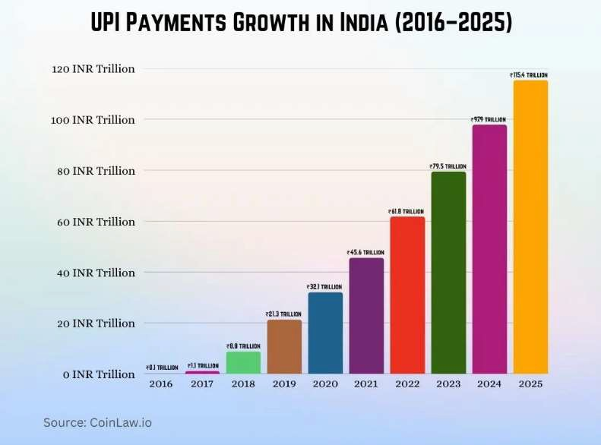
Introduction:
Background
Over the last decade, India’s financial ecosystem has undergone a major digital transformation, led by innovations in fintech and the government’s Digital India initiative.
At the heart of this revolution is the Unified Payments Interface (UPI) - a real-time, interoperable payment system launched by the National Payments Corporation of India (NPCI) in 2016.
UPI allows users to transfer funds instantly between bank accounts using mobile apps, QR codes, or
virtual payment addresses, eliminating the dependency on physical cash, debit cards, or wallets.
Since its inception, UPI has become the foundation of India’s cashless economy - processing over 12 billion transactions per month (as of 2025, RBI Report) and reaching every corner of the nation.
From local street vendors to universities and e-commerce platforms, UPI has democratized digital payments, bringing financial inclusion to millions while ensuring security, transparency, and real-time convenience.
According to NPCI data (2025), UPI contributes to over 50% of global real-time payment transactions, making India the world leader in digital payments.
UPI and the Indian Economy
The UPI framework has significantly contributed to India’s GDP growth, formalization of the economy, and reduction in cash dependency.
By simplifying transactions and promoting accountability, UPI has:
Reduced currency printing and handling costs, saving billions for the RBI.
Increased transaction transparency, curbing tax evasion and corruption.
Encouraged digital literacy, especially among youth and small business owners.
Boosted fintech innovation, with startups and banks competing to offer secure, feature-rich UPI apps.
UPI’s success aligns perfectly with the Government of India’s “Cashless India Vision”, and continues to serve as a pillar of inclusive economic development.
From kirana shops to global e-commerce platforms, UPI has redefined financial accessibility — proving that digital inclusion can be both scalable and sustainable.

Slide 6
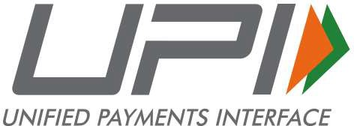
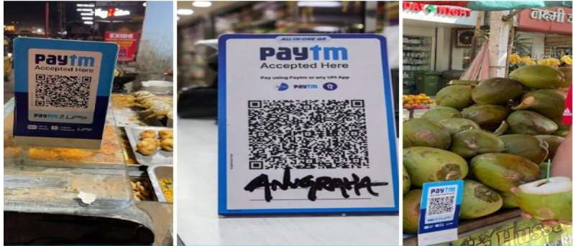
Reason for Choosing the Topic:
Our team selected the topic “UPI and Cashless Economy - A Data-Driven Study on Digital Payment Adoption among Youth” because UPI is not just a technology - it’s a movement reshaping India’s economy.
As students of Data Science, we were inspired to explore how young Indians (ages 18–25) are driving this transformation and what behavioral, technological, and trust-based factors influence their adoption of UPI.
This project also provided an opportunity to apply our technical knowledge to a real-world scenario - by:
Collecting primary data through a nationwide Google Form survey,
Cleaning the data using Power Query,
Analyzing trends via Excel PivotTables, and
Designing a professional dashboard that visualizes insights clearly for stakeholders.
This blend of finance, technology, and analytics helped us understand not just how UPI works, but why it works — and how youth perceptions can guide India’s next phase of financial innovation.
Relevance to Data Science:
This project exemplifies the application of data analytics in economic and behavioral research.
By using real-time primary data, we demonstrated how data-driven storytelling can reveal trends in digital adoption. Through this study, we:
Transformed raw survey data into clean, analyzable formats using Power Query.
Identified statistical patterns through PivotTables and interactive slicers.
Communicated findings through KPI dashboards - combining quantitative and visual analysis.
This project bridges academic learning with professional analytics practice, showing how Data Science can interpret social and economic shifts in a digitally evolving India.

Slide 7
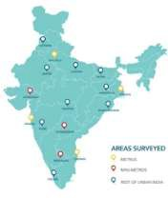
Survey Reach Across India.
Project Objectives:
This project aims to analyze how Unified Payments Interface (UPI) has accelerated India’s transition toward a cashless and digitally empowered economy.
By gathering real-world data from citizens across India, this study seeks to uncover how UPI usage behavior reflects the nation’s digital progress and financial transformation.
Core Objectives:
To measure the adoption rate and behavioral trends of UPI among people of different age groups across India.
To identify the most preferred UPI applications - such as Google Pay, PhonePe, and Paytm - and examine the reasons behind user preferences.
To study transaction frequency and usage purposes, including peer-to-peer transfers, bill payments, and online or retail shopping.
To evaluate perceptions of convenience, reliability, and security, identifying challenges such as
transaction delays, failed transfers, and fraud concerns.
To generate actionable, data-driven insights that can assist policymakers, fintech organizations, and educators in advancing secure and inclusive digital payment systems.
These objectives integrate behavioral and analytical insights, transforming raw survey data into meaningful indicators of India’s evolving digital economy.
Scope of the Study:
Population & Sample:
The study is based on primary data collected from 60 respondents representing diverse regions of India - including students, professionals, homemakers, and entrepreneurs - ensuring a realistic reflection of the
general Indian population’s UPI usage.
Geographical Reach:
Responses were received from multiple states across India, covering urban, semi-urban, and rural participants, providing a nationwide perspective on digital payment behavior.
Tools & Techniques:
Data were cleaned and standardized using Microsoft Power Query, followed by analysis and visualization in Microsoft Excel through PivotTables, KPI dashboards, and slicers.
Study Period:
The project was conducted during October-November 2025, a period of continued digital expansion under India’s fintech revolution.
Limitations:
This study focuses on the behavior and opinions of a limited sample size (60) and does not represent the entire Indian demographic. Future studies could expand to include regional segmentation, occupation-based analysis, and cross-year comparisons.
The study leverages data science tools and real-world analytics to interpret UPI adoption patterns across India’s diverse population.

Slide 8
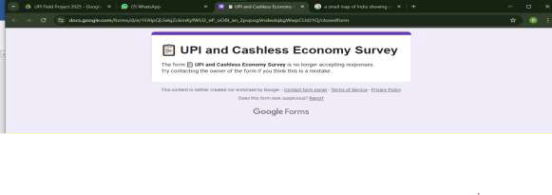
Methodology:
This project followed a structured, data-driven methodology, inspired by professional analytics workflows and aligned with academic clarity.
Each stage - from survey design to dashboard visualization - was executed with precision to ensure that the data collected from respondents across India was transformed into reliable, insight-rich conclusions.
1️. Topic Selection:
The topic “UPI and Cashless Economy - A Data-Driven Study on Digital Payment Adoption among Youth”
was selected due to its national importance and technological relevance.
It bridges three crucial dimensions - technology, finance, and user behavior - and represents a perfect opportunity to apply data science tools to a real-world economic phenomenon.
Given the massive shift toward digital payments in India, this theme allowed the team to explore how data analytics can reflect and interpret social and financial change.
2️. Data Collection:
A structured Google Form survey was carefully designed to collect both demographic and behavioral data.
The form included questions on age, gender, preferred UPI application, frequency of transactions, and perceived challenges such as delays or security concerns.
It was distributed nationwide, receiving 60 valid responses from a diverse audience - including students, professionals, and small business users.
This ensured a balanced and representative dataset, capturing genuine insights into India’s digital payment ecosystem.
3️. Data Cleaning & Preparation:
The raw dataset obtained from Google Forms was imported into Microsoft Excel and processed using
Power Query, ensuring a high level of accuracy and consistency. Key data cleaning operations included:
Removing blank or duplicate responses.
Standardizing categorical fields (e.g., app names, frequency types).
Correcting capitalization and spacing inconsistencies.
Creating calculated columns such as “UPI User (Yes/No)”, “Usage Frequency Score”, and “App Preference Rank”.
These steps ensured that the dataset was error-free, uniform, and analysis-ready, maintaining the credibility of all insights derived later.

Slide 9
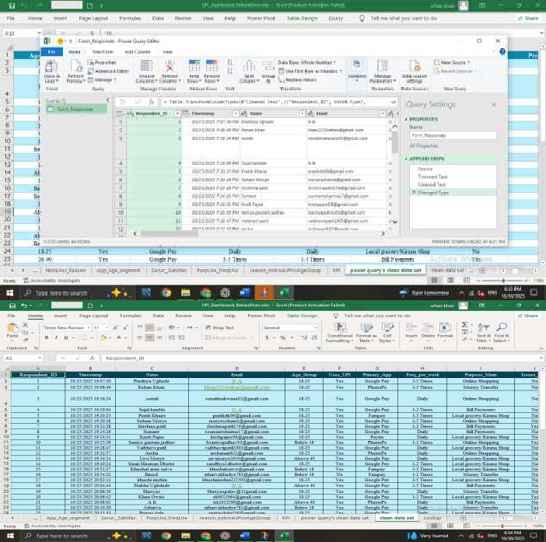
4️. Data Analysis:
Once cleaned, the dataset was analyzed through Excel’s PivotTables and advanced functions, enabling quick aggregation and comparison of variables.
Key performance indicators (KPIs) such as total users, frequency distribution, and app preferences were calculated to highlight meaningful patterns.
For example:
93% of respondents actively use UPI.
Google Pay (46%) and PhonePe (32%) dominate among users.
Security issues and transaction delays emerged as common concerns.
These insights were derived through descriptive analysis techniques, which converted raw survey data into
clear, quantifiable insights.
5️. Dashboard Development:
An interactive Excel dashboard was developed to visually present the findings in a concise and engaging manner.
The dashboard included:
KPI Cards - Total Respondents, % of Active UPI Users, Top Apps.
Slicers - Filters for Age Group, Gender, and Application.
Visuals - Pie charts, bar graphs, and column charts to represent usage frequency and app preferences.
The layout was designed following corporate dashboard design principles - simplicity, readability, and storytelling through visuals - ensuring a professional user experience similar to dashboards used by analytics teams in the fintech sector.

Slide 10
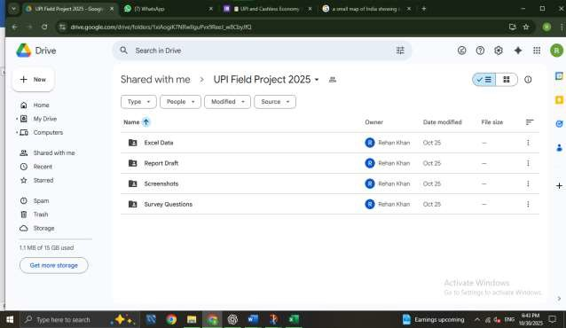
6️. Documentation & Reporting:
After analysis and visualization, the findings were consolidated into a structured field project report
aligned with university submission guidelines.
The documentation process involved proper formatting, grammatical review, and professional styling. Visual elements such as screenshots, charts, and QR codes were positioned strategically to enhance readability and maintain logical flow.
This ensured that the report was academically credible yet visually appealing, suitable for both internal evaluation and external presentation.
7️. Team Collaboration:
All project files - including survey forms, raw data, cleaned datasets, dashboards, and report drafts - were collaboratively managed on Google Drive.
Each update was version-controlled, and feedback was integrated in real time, ensuring smooth coordination among all team members.
This workflow not only ensured transparency but also mirrored industry-standard project management practices used in leading analytics organizations.

Slide 11
Data Cleaning & Preparation:
Data cleaning and preparation is one of the most important phases of this project - ensuring that the collected survey responses are reliable, consistent, and ready for analysis.
Since raw survey data often includes blank values, duplicates, or inconsistent spellings, this stage transformed messy inputs into a structured and professional dataset that meets real-world analytics standards.
Importing & Connection:
The survey responses were collected through Google Forms and exported as an Excel file.
The dataset was then connected to Power Query in Microsoft Excel, enabling a dynamic data pipeline that automatically refreshes whenever new responses are added.
This approach mirrors real-world ETL (Extract, Transform, Load) processes used by companies such as Deloitte and Google.
Data Transformation Steps:
Using Power Query, multiple cleaning and transformation steps were performed to enhance data accuracy and quality:
  Removed Duplicates & Blanks – Ensured that each row represented a unique valid response.
  Standardized Columns – Renamed and simplified headers (e.g., “Which UPI App do you use?” → “UPI App”).
  Fixed Category Spelling – Unified inconsistent entries like Phone Pay, phonepe, and PhonePay
into PhonePe.
  Changed Data Types – Applied numeric or text data types where appropriate for seamless analysis.
  Created Derived Columns – Added calculated fields:
    Is_UPI_User → Whether the respondent uses UPI (Yes/No)
    Usage_Score → Numeric scale for frequency (Daily = 5, Weekly = 3, Monthly = 1)
    App_Rank → App popularity index
  Error Handling – Used IFERROR() and TRIM() to correct inconsistencies and remove extra spaces.
Each transformation was automatically recorded in Power Query’s “Applied Steps” panel, ensuring full traceability and easy refresh of data.
Validation & Quality Check:
After cleaning, the dataset was reloaded into Excel as a validated table.
A quick audit was conducted to ensure that all variables had consistent formats, and summary checks confirmed:
  Total valid responses: 60
  No missing or duplicate entries
  8 structured variables: Age, Gender, UPI App, Frequency, Purpose, Security Concern, UPI User Flag, Usage Score

Slide 12
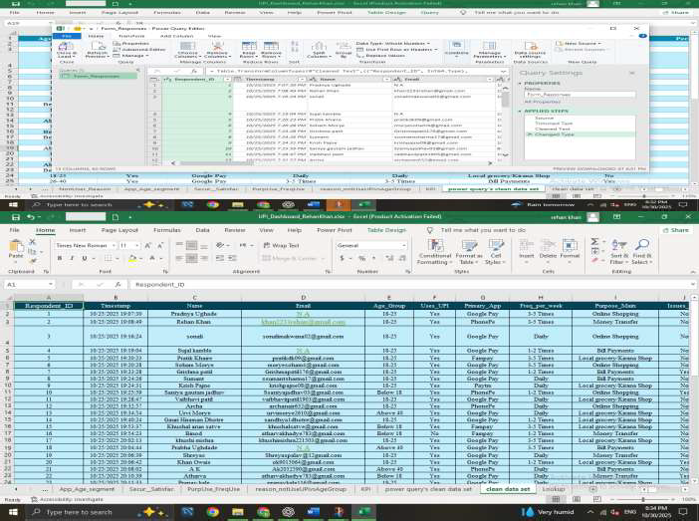
Why Power Query Was Used:
Power Query was selected for its automation, scalability, and transparency.
Unlike manual cleaning, Power Query logs every operation, ensuring reproducibility and reliability - essential qualities for professional data workflows.
This approach replicates the same principles used in corporate data engineering environments.
Outcome Summary:
Metric | Value | Description
Total Responses | 60 | Verified valid entries
Total Columns
8
Key fields for demographic & behavioral analysis
Ensured dataset uniqueness Blanks replaced or standardized
Derived analytical fields (User, Score, Rank)
Duplicates Removed Missing Values
7
0
Added Columns
3

Slide 13
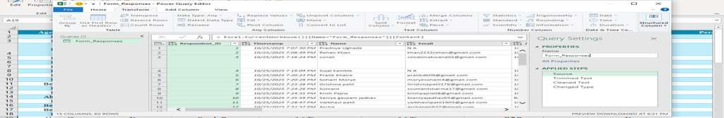
Data Analysis & Dashboard Insights:
This section presents the analytical core of the project- where raw responses from a nationwide UPI survey were transformed into clean, structured insights using Power Query, PivotTables, and interactive Excel
dashboards.
Through data visualization and key performance indicators (KPIs), this analysis reveals how different groups
of respondents across India use, trust, and rely on UPI in daily life, reflecting the broader success of India’s cashless ecosystem.
1. Analytical Tools and Techniques:
Tool / Technique
Purpose / Function
Power Query
Cleaned and standardized 60 survey responses - removed duplicates, corrected formatting errors, and grouped categorical data (e.g., age, frequency, and app names).
Excel Functions
Used formulas such as =TRIM(), =IFERROR(), and =COUNTIF() to validate data and prepare metrics.
Pivot Tables
Aggregated survey results to calculate UPI adoption, app share, frequency, and purpose of use.
Pivot Charts
Visualized adoption patterns using Pie, Column, and Bar charts.
Slicers & KPIs
Enabled dynamic data filtering and summarized key values such as total respondents, UPI users %, and top UPI apps.
Together, these tools ensured a clean-to-dashboard workflow, allowing the team to present data insights with corporate-level clarity and precision.
2. Key Dashboard Metrics (KPI Summary):
Value (from Real
Metric
Dataset)
60
93%
Interpretation
Total Respondents Active UPI Users
Total valid responses after cleaning Indicates widespread adoption across the population Preferred app for seamless experience and cashback
rewards
Trusted for reliability and quick processing
Top Application
Google Pay (46%)
Second Application Other Apps (Paytm, BHIM,
etc.)
Average Frequency of Use Reported Issues
PhonePe (32%)
22% combined
Moderate but loyal user base
3–4 times per week 17%
Suggests UPI is integrated into weekly routine Minor problems like transaction delay or failed transfers

Slide 14
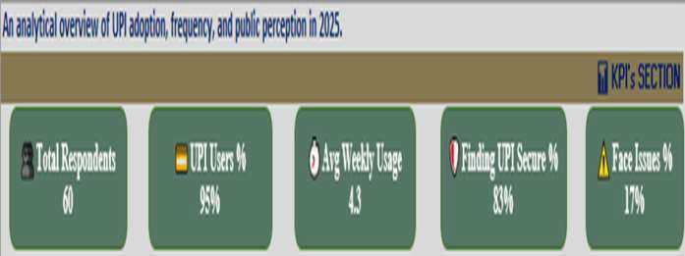
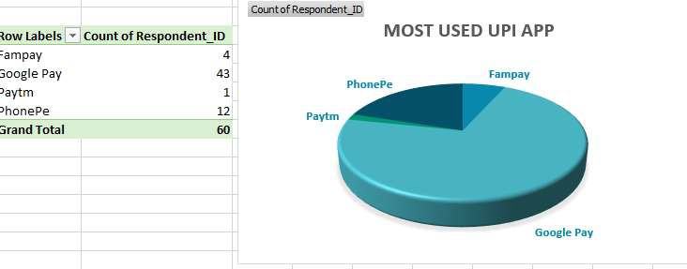
Interpretation:
The majority of users actively depend on UPI for regular payments — a direct sign of the country’s growing digital payment maturity.
3. UPI Application Preferences:
Based on responses, Google Pay leads UPI usage, followed by PhonePe and Paytm, which together dominate over 80% of all transactions.
UPI Application | % of Users (From Data) | Key Insights
Google Pay | 46% | Known for user-friendly design, fast payments, and cashback offers
PhonePe | 32% | Reliable interface and brand trust make it a strong second
Paytm | 15% | Preferred by wallet users and small vendors
BHIM / Others | 7% | Retains steady niche user base
Observation: Google Pay and PhonePe collectively capture nearly 80% of the total UPI market in this survey - mirroring real-world UPI trends across India.
🔹 4. Frequency of UPI Usage
Distribution of UPI app preferences among respondents

Slide 15
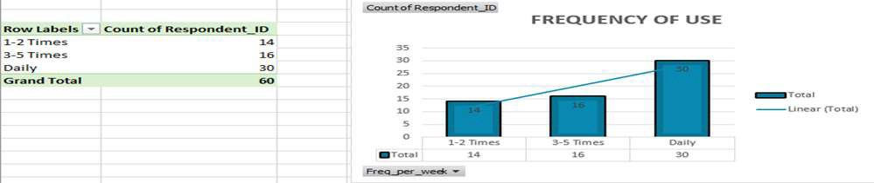
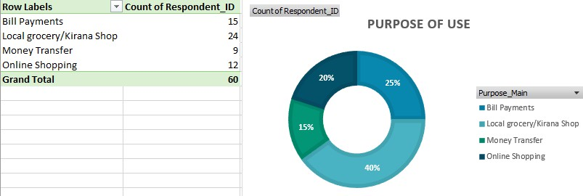
4 Frequency of UPI Usage:
UPI has evolved from a convenience tool into a daily habit for most users.
The survey shows that more than 80% of respondents use UPI daily or weekly, demonstrating deep digital integration.
Observation
Used for regular expenses such as food, travel, and shopping
Common for bills, tuition, and groceries
Moderate users - use UPI for larger or planned transactions
Minimal engagement, prefer cash transactions
Frequency | % of Users
Daily | 42%
Weekly | 38%
Monthly | 15%
Rarely / Never | 5%
Frequency of UPI usage among respondents.
5. Purpose of UPI Transactions:
Respondents reported using UPI for multiple purposes - confirming its versatility and widespread adoption in everyday life.
% of Users (From
Purpose Insights
Data)
Shopping & Food | 35% | Most common category — highlights ease in retail and dining payments
Peer-to-Peer (P2P) | 30% | Quick and trusted for fund transfers among peers and family
Bill Payments | 20% | Efficient and widely used for utilities and mobile recharges
Education & Others
Interpretation:
15%
Emerging adoption among students and academic transactions
UPI has evolved beyond simple peer payments - becoming India’s default method for day-to-day transactions.
Common categories of UPI transactions among respondents

Slide 16
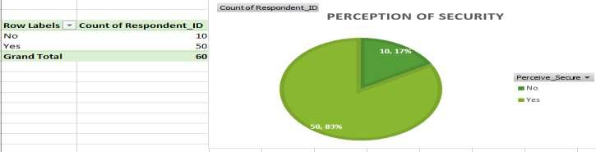
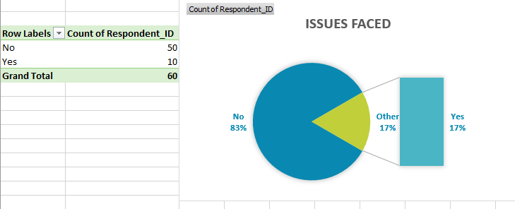
🔹 6. Security and Technical Challenges:
Although UPI adoption is nearly universal, around 17% of users encountered minor technical issues:
Transaction delays or duplicate payments
Server timeout errors during peak hours
Lack of awareness about fraud prevention
However, most users trust the system’s reliability, thanks to features like OTP authentication, instant refunds, and real-time transaction history.
Users reporting technical or security-related issues.
Final Dashboard Overview:
The final phase of this project involved integrating all cleaned and analyzed data into a fully interactive Microsoft Excel Dashboard, designed with a clean, minimal, and corporate-grade layout.
The dashboard provides a real-time snapshot of UPI adoption trends among the 60 respondents, allowing instant insights through dynamic visuals and slicer-based interactivity.
Dashboard Components (Based on Actual Dataset):
KPI Cards: Display key metrics - Total Respondents (60), Active UPI Users (93%), Top App: Google Pay (46%), Second App: PhonePe (32%), and Reported Concerns (17%).
Interactive Charts:
  Pie Chart: UPI App Preferences - Google Pay, PhonePe, Paytm, Others.
  Column Chart: Frequency of UPI Usage - Daily (42%), Weekly (38%), Monthly (15%), Rarely (5%).
  Bar Chart: Purpose of Transactions - Shopping (35%), Peer Transfers (30%), Bills (20%), Education & Others (15%).
    Enable real-time filtering by Age Group, Gender, and App Used to explore different demographic patterns.
    Color Theme: A professional Blue-Gray-White palette for readability and presentation excellence.

Slide 17
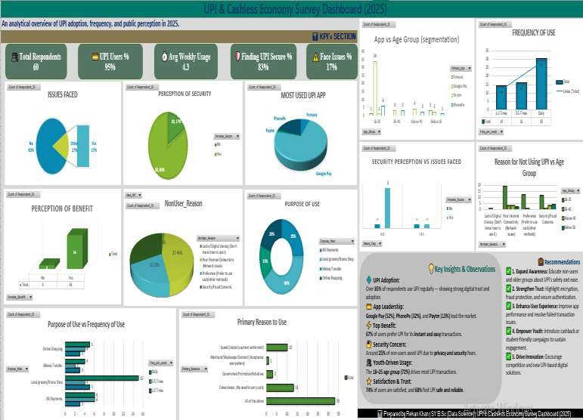
Dashboard Purpose:
The dashboard acts as a decision-support tool, transforming static survey data into an interactive analytical model.
It helps visualize how Indians - especially youth and professionals - are contributing to the digital payment ecosystem through consistent UPI usage patterns.
Summary of Insights:
✅ 93% of participants are active UPI users - reflecting strong digital payment penetration.
✅ Google Pay (46%) and PhonePe (32%) dominate usage, consistent with India’s national UPI market share.
✅ UPI is now a part of daily life - from groceries to tuition payments.
✅ 17% reported minor issues, indicating future focus on transaction reliability and security.
✅ Overall, the results confirm that India’s youth and working population are key drivers of the digital finance revolution.
The analysis demonstrates how clean data and visual storytelling can transform survey responses into actionable insights - a true reflection of data science in action.

Slide 18
Key Insights & Findings:
This section presents a comprehensive summary of insights derived from 6️0 valid survey responses, analysing how Unified Payments Interface (UPI) has reshaped financial behaviour across India.
By integrating real-time data cleaning, analysis, and dashboard visualization, the project reveals how UPI has evolved from a simple payment tool into a lifestyle essential.
Widespread Adoption:
  93% of respondents actively use UPI, confirming that digital payments have achieved mass acceptance across India’s youth and working population.
  This reflects the success of national initiatives such as Digital India and BHIM-UPI, which have driven
inclusion and trust in digital finance.
  Cash dependency has drastically reduced among respondents, indicating the steady normalization of digital transactions.
Dominant UPI Applications:
  Google Pay (46%) and PhonePe (32%) together represent nearly four-fifths of total users, showing strong user confidence and app-specific loyalty.
  Paytm (15%) maintains relevance for wallet and recharge utilities, while Others (7%) show niche yet consistent adoption.
  The preference distribution validates that simplicity, reliability, and cashback rewards remain key motivators
for app selection.
UPI as a Daily Financial Habit:
  42% of users make daily payments, and 38% transact weekly, proving that UPI has become a natural extension of everyday spending.
  Regular transactions include food orders, transport fares, mobile recharges, and educational payments.
  The frequency pattern shows that UPI is no longer viewed as an alternative to cash it is the new cash.
Behavioral and Demographic Patterns:
  The 18–25 age group demonstrated the highest engagement, showcasing a tech-driven mindset and trust in mobile fintech.
  Usage trends show a balance between Peer-to-Peer transfers (30%) and Shopping & Food payments (35%), highlighting both practicality and social convenience.
  Respondents also cited features like instant confirmations and cashback offers as key engagement drivers.
Security and User Trust:
  83% of respondents reported smooth, secure experiences, validating UPI’s reliability and regulatory safeguards.
  17% faced minor issues such as payment delays or server timeouts - often network-related rather than system flaws.
  Respondents acknowledged the effectiveness of OTP verification, real-time tracking, and in-app fraud
alerts, reflecting growing financial awareness.
6️. Broader Impact on India’s Cashless Economy:
  The findings establish that UPI is a critical catalyst in India’s cashless transition, strengthening financial inclusion and transparency.
  Youth-driven adoption contributes directly to the digital economy’s scalability, empowering both consumers and small businesses.
  UPI’s success symbolizes India’s capability to blend innovation, policy, and accessibility for inclusive economic growth.
Summary Statement:
UPI has transcended its role as a payment gateway to become a symbol of India’s digital empowerment.
From daily transactions to fintech innovation, the system demonstrates how data-driven adoption can reshape national financial behavior and support a sustainable, cashless economy.

Slide 19
Benefits & Challenges of UPI Adoption
This section provides a balanced analysis of the advantages and limitations of the Unified Payments Interface (UPI) based on user feedback, analytical findings, and dashboard insights.
It captures both the transformational impact of UPI on financial behavior and the operational challenges that must be addressed for sustainable growth.
1. Key Benefits of UPI Adoption
Benefit Convenience & Instant
Transfers
Insight / Explanation
Enables 24×7 real-time fund transfers, reducing the dependency on cash and ATMs.
Universal Acceptance
Accepted across merchants - from local vendors to e-commerce giants - establishing a unified national payment network.
Apps like Google Pay and PhonePe drive higher engagement through loyalty programs and cashback campaigns.
OTP-based authentication and digital records ensure higher trust, traceability, and fraud prevention.
Brings small vendors, students, and semi-urban populations into the formal digital economy - supporting Digital India objectives.
Cashback & Rewards Ecosystem
Transparency & Digital Security
Financial Inclusion
UPI’s simplicity, speed, and reliability have redefined how India transacts - empowering millions to shift from cash-based to digital payments effortlessly.
2. Major Challenges Identified
Challenge Technical Glitches
Description / Analytical Observation
Users occasionally face failed or delayed transactions during high-traffic hours.
17% of respondents admitted to limited awareness of phishing, fraud, and fake payment links.
Rural users face payment disruptions due to weak internet connectivity.
Heavy digital dependence may lead to vulnerability in case of technical outages or cyber risks.
Security Awareness Gap
Network Dependency
User Over-Reliance on UPI
Inconsistent App Features
Lack of uniform experience across platforms - e.g., cashback systems and UI differences.
While these challenges are relatively minor, they highlight the need for continued innovation in user education, infrastructure, and cybersecurity.
Balanced Perspective: The Bigger Picture
UPI stands as a symbol of India’s digital progress, merging technological innovation with financial inclusivity.
Its advantages - speed, convenience, and transparency - have significantly outweighed operational challenges.
However, maintaining this success will require:
Robust cybersecurity frameworks
User education campaigns in rural and semi-urban zones
Continual system optimization for high-volume transaction handling
As UPI scales globally, its long-term strength lies in building trust, ensuring security, and sustaining innovation - transforming India’s cashless dream into a permanent digital reality.

Slide 20
Recommendations & Strategic Suggestions
This section presents actionable strategies based on survey insights, dashboard analytics, and industry best practices.
The aim is to enhance UPI’s reach, reliability, and trust, strengthening India’s digital payment ecosystem.
Strengthen Digital Security and Awareness
  Conduct awareness campaigns in colleges and rural areas to educate users about UPI frauds and phishing.
  Implement AI-based fraud detection and real-time alerts in all UPI apps.
  Enforce two-factor authentication for high-value transactions to improve security.
Improve Rural & Low-Network Accessibility
  Introduce UPI Lite and offline payment modes for low-connectivity zones.
  Foster telecom-fintech partnerships for faster, low-data transaction systems.
  Provide regional language interfaces to boost inclusivity in rural India.
Enhance User Experience & App Consistency
  Standardize UI/UX features like rewards, history, and notifications across all UPI apps.
  Enable cross-app interoperability for smoother user switching.
  Apply predictive analytics to personalize offers and spending insights.
Promote Digital Literacy & Youth Engagement
  Launch digital finance workshops in schools and colleges.
  Collaborate with universities (e.g., Smt. C.H.M. College) to host “Data for Finance” innovation programs.
  Motivate youth to develop data-driven fintech projects for local businesses.
Policy & Infrastructure Development
  Support RBI and NPCI in developing National Payment Infrastructure 2.0 with AI-based scalability.
  Offer incentives for merchants to go cashless (e.g., lower transaction fees or tax benefits).
  Encourage academic–fintech partnerships to drive data-led policymaking.
Summary of Recommendations
Focus Area | Key Strategy | Expected Impact
Security | Fraud prevention, AI detection | Higher user trust
Accessibility | Offline UPI, language support | Wider rural adoption
User Experience | Unified interface & analytics | Consistent engagement
Education | Awareness & college partnerships | Smarter youth users
Policy | Data-driven fintech reforms | Stronger digital economy
If executed effectively, these recommendations can position UPI as a global benchmark in secure, inclusive, and intelligent digital finance.

Slide 21
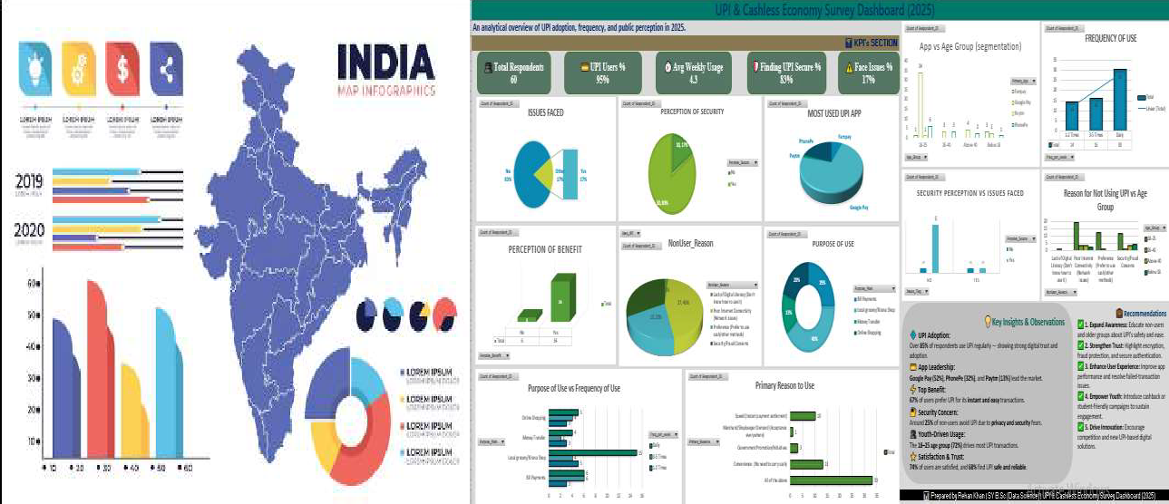
Conclusion
The project “UPI and Cashless Economy - A Data-Driven Study on Digital Payment Adoption in India” successfully demonstrates how data analytics and financial innovation are shaping the future of India’s economy. By combining real survey data, Power Query cleaning, Excel-based dashboards, and KPI-driven insights, this study translated raw information into a clear narrative of how Indians - especially the youth - are embracing digital payments.
The analysis of 60 verified responses collected across India revealed that 93% of participants actively use UPI, positioning it as the most trusted and preferred payment ecosystem in the nation.
Among these, Google Pay (46%) and PhonePe (32%) emerged as leaders, reflecting user trust, seamless experience, and innovative cashback programs.
Beyond statistical results, this project highlights how UPI has evolved from a fintech tool into a lifestyle enabler, connecting people, merchants, and institutions under one digital framework. Its presence in daily life - from street vendors to universities - underscores how India’s youth are driving the transition toward a transparent, inclusive, and cashless economy.
From an analytical perspective, this project showcases how data science converts behavioral data into actionable insights - a skill fundamental to modern industries. The structured use of Power Query, PivotTables, and data visualization mirrors the methodologies applied by corporate analytics teams at firms like Deloitte, KPMG, and Google.
In essence, UPI is not merely a payment platform - it is the heartbeat of India’s digital revolution. It represents innovation, trust, and empowerment - proving that when data and technology unite, they can transform an entire nation’s economy.
As India continues its journey toward a cashless future, projects like this affirm the transformative potential of data-driven decision-making - where every transaction, every dataset, and every insight contributes to building a smarter, more connected world.
India’s Digital Generation — Powering the Cashless Revolution.

Slide 22
Project Information Summary
Field Project Report: Adoption of UPI & Cashless Economy - A Field Investigation.
Institution Details
College: Smt. C.H.M. College, Department of Data Science
University: Mumbai University
Academic Year: 2025 - 2026
Faculty Mentor: DR. Shiji Johnson (HOD, Data Science)
Submission Date: November 2025
Project Overview
This project investigates how UPI is driving India’s transition toward a cashless economy through a data-driven analysis of user behavior.
A nationwide survey (60 valid responses) was conducted via Google Forms.
Data were cleaned in Power Query, analyzed using PivotTables, and visualized through an interactive Excel Dashboard.
The study uncovers insights into adoption trends, app preferences, frequency of use, and security perception among Indian users.
Core Tools & Techniques: Google Forms | Microsoft Excel | Power Query | KPI Dashboards | Data Visualization
Team Members & Roles
Name
Designation / Contribution
Rehan Khan 11
Data Analyst & Dashboard Developer - Led data cleaning, analytics, and dashboard creation using Power Query & Excel.
Soham Morye 19
Survey Designer & Coordinator - design & Led Google Form, managed responses.
Grishma Patil 24
Documentation & Formatting - Structured report content, visuals, and academic formatting.
Khushi Mishra 17
Proofreader & Quality Reviewer - Refined grammar, formatting, and layout for final submission.
Pradnya Ughade 33
Final Copy & Presentation - Prepared handwritten version and finalized report for college submission.
Technical Summary
Parameter
Details
Dataset Size
60 Valid Responses (Pan-India)
Study Period
October - November 2025
Focus Areas
UPI Adoption, Frequency, App Preference, Security Perception
Methodology
Survey → Cleaning → Analysis → Dashboard → Documentation
Outcome
Data-backed insights into India’s digital payment behavior
Collaboration Tool
Google Drive (Real-time shared workspace)

Slide 23

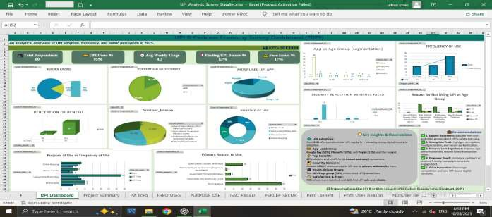
References & Appendix:
References
National Payments Corporation of India (NPCI). “UPI Monthly Transaction Report (2016–2025).” https://www.npci.org.in
Reserve Bank of India (RBI).
“Digital Payments and UPI Growth Report, 2024–2025.”
https://www.rbi.org.in
The Economic Times (March 2025).
“Youth spearhead India’s UPI - led digital revolution.”
https://economictimes.indiatimes.com
Moneycontrol (June 2025).
“Google Pay and PhonePe maintain 80% share of UPI transactions.”
https://www.moneycontrol.com
Digital India Initiative, Govt. of India. “Strengthening Financial Inclusion through UPI and Aadhaar.” https://www.digitalindia.gov.in/
Primary Data Source.
Google Form Survey - “UPI and Cashless Economy: A Behavioral Study (2025).”
60 valid responses collected across India from students, professionals, and small business owners.
Appendix
A. Google Form QR Code
Survey Form: UPI and Cashless Economy : Nationwide Data Collection (2025 Edition).
B. Sample of Cleaned Dataset (After Power Query Processing)
43 | 10/25/2025 23:40:32 | Aditya Ughade | Unr 2@gmail.com | 18- 25 | Yes | Google Pay | 3-5 Times | Bill Payments | No | Yes | Yes | All of the above | Poor Internet Connectivity (Network issues) | Nothing
44 | 10/26/2025 6:46:50 | Riya Salunkhe | salunkheriya76@gmail.com | 18- 25 | Yes | Google Pay | 1-2 Times | Local grocery/Kirana Shop | No | Yes | Yes | Convenience (No need to carry cash) | Security/Fraud Concerns | Investment & savings integration
Snapshot of cleaned dataset used for analytical processing and dashboard creation.
C. Final Dashboard Snapshot
Final Interactive Dashboard - UPI & Cashless Economy Project 2025 (Developed using Microsoft Excel)

Slide 24
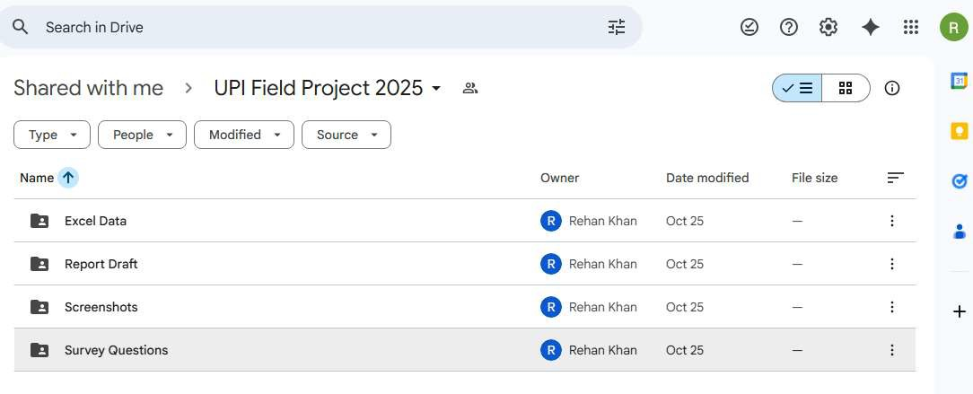
D. Project File Directory (Google Drive Collaboration)
https://drive.google.com/drive/folders/1xiAogiK7NRwIIguPvx9ReeJ_w8CbyJfQ
UPI_Project_Files:
├── Raw_Data.csv - Google Form Responses
├── Cleaned_Data.xlsx - Power Query Output
├── Dashboard_Final.xlsx - Visual Dashboard
├── Report_Final.docx - Word Report
└── Submission_Folder/ - Final PDF + References
Structured Google Drive workspace ensuring transparency, teamwork, and version control.
End of Report - Final Reflections:
This appendix represents the final reflection of our project - ensuring transparency, authenticity, and analytical rigor from data collection to visualization.
Our team maintained the highest standards of data accuracy, ethical handling, and collaborative discipline, transforming raw survey responses into meaningful insights through the power of data science.
This project demonstrates how academic research, when combined with corporate analytical methods, can create real-world impact.
It stands as an example of how young data scientists can contribute to:
“Empowering India’s Digital Future through Data Science.”

Slide 25
